Slide 1
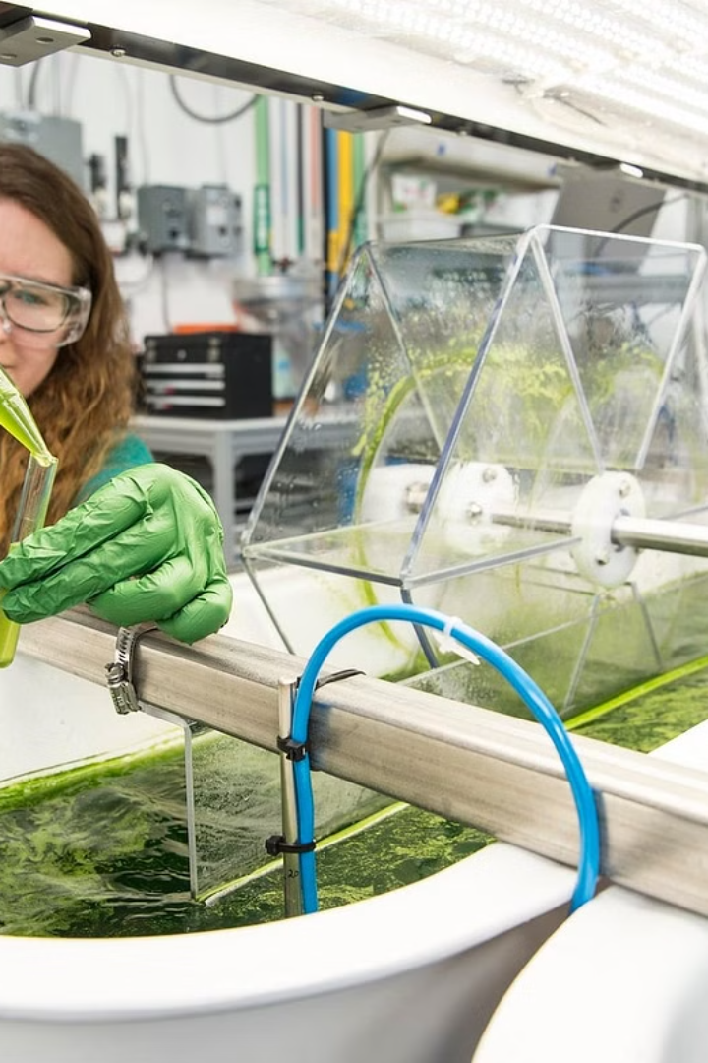
Harnessing the Power of Algae: Biofuel of the Future

Slide 2
TEAM MEMBERS
NAME | ROLL NO
B L NARASIMHAM | 2110030001
DOMMATA HARDHAVARDHAN REDDY | 2110030109
B V V L N BHARGAV | 2110030150
JAINA VAMSHI | 2110030153

Slide 3

Cultivating Algae for Biofuel
Species Selection
1
Choosing the right algae species is crucial, considering factors like oil content, growth rate, and environmental tolerance.
2
Growth Conditions
Algae are grown in ponds or bioreactors, provided with sunlight, nutrients, and carbon dioxide.
Harvesting
3
Mature algae are harvested using methods like centrifugation, sedimentation, or filtration.

Slide 4
Processing Algae for Biofuel
Cell Disruption
Oil Extraction
Drying and Purification
The harvested algae biomass undergoes processing to extract biofuel precursors.
The extracted biofuel precursors are then converted into usable biofuels.
The raw biofuel may need further purification and upgrading to meet quality standards.

Slide 5



Biofuel Applications
Transportation
Power Generation
Cost Competitiveness
Algae-based biodiesel and jet fuel can power vehicles and aircraft.
Algae-based biodiesel and renewable natural gas can generate electricity.
Technological advancements and carbon pricing could make algae biofuel competitive.

Slide 6
Challenges in Algae Biofuel Production
1
High Cultivation Costs
2
Inefficient Processing
3
Scale-up Challenges
Most algae biofuel production is currently at small demonstration scales.
Growing algae requires significant resources, making it expensive compared to traditional crops.
Extracting and converting algae oil into usable fuel is complex and energy-intensive.

Slide 7
Strategies to Reduce Algae Biofuel Costs
Improve Algae Strains
Optimize Cultivation
Develop strains with higher oil content, faster growth, and better environmental tolerance.
Design closed-loop systems that minimize water and resource requirements.
Enhance Processing
Increase Scale
Improve extraction methods and explore alternative conversion pathways.
Move from pilot projects to larger-scale facilities to benefit from economies of scale.

Slide 8
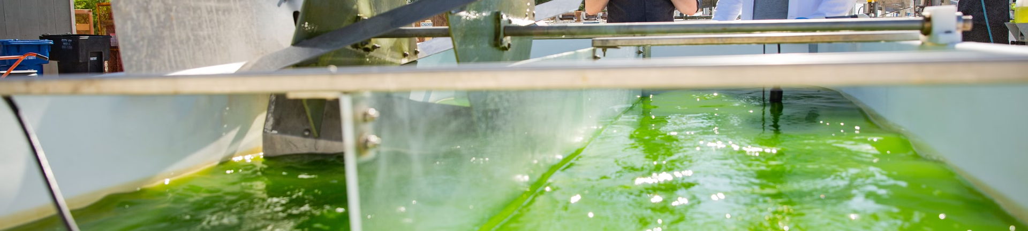



Integrating Algae Biofuel into Existing Infrastructure
Leverage Pipelines
Develop Co-products
Supportive Policies
Utilize existing pipelines, refineries, and distribution networks to minimize investment.
Utilize other valuable components of algae biomass to generate additional revenue.
Implement carbon pricing and provide research funding to drive adoption.

Slide 9
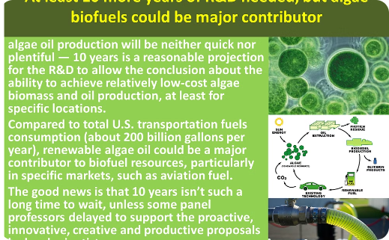
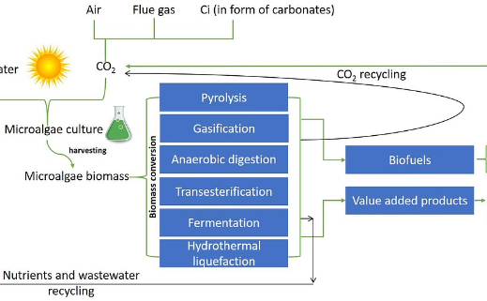
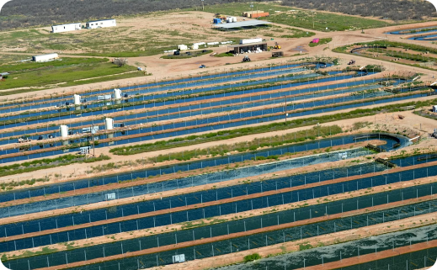
The Future of Algae Biofuel
Technological Advancements
Environmental Benefits
Scaling Up Production
Algae biofuel has a lower carbon footprint compared to traditional fossil fuels.
Larger-scale facilities and integration with existing infrastructure will drive down costs.
Breakthroughs in areas like genetic engineering and bioconversion could significantly reduce production costs.

Slide 10
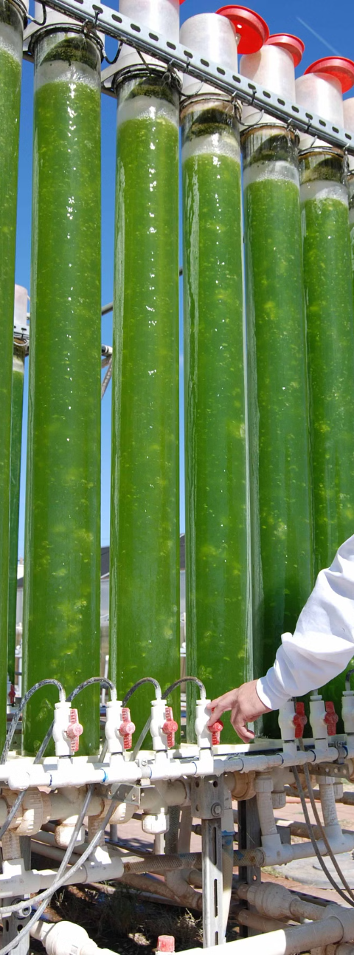
Harnessing the Potential of Algae Biofuel
1
Cultivation
Selecting the right algae species and optimizing growth conditions are crucial.
2
Processing
Efficient extraction and conversion methods are key to reducing costs.
3
Integration
Leveraging existing infrastructure and developing co-products can boost viability.

Slide 11

Algae-Based Biofuels: Promising Solutions
Algae-based biofuels hold promise as a sustainable alternative to fossil fuels. Technological advancements and carbon pricing could help make them cost-competitive in the future.

Slide 12
Improving Cultivation
Strain Development
Optimized Systems
Alternative Methods
Breeding algae strains with higher oil content, faster growth, and better tolerance can reduce costs.
Closed-loop cultivation systems that minimize water and nutrient needs can boost efficiency.
Exploring options like photobioreactors and biofilms can improve scalability and productivity.

Slide 13
Advancing Processing
1
Extraction
Developing efficient oil extraction techniques can reduce energy consumption and improve yields.
2
Conversion
Investigating alternative conversion pathways, like biocrude or bioethanol, can leverage existing infrastructure.
3
Purification
Optimizing downstream processing can minimize energy use and waste generation.

Slide 14

Scaling and Integration
Increase Scale
Leverage Infrastructure
Moving beyond pilot projects to larger facilities can leverage economies of scale.
Integrating with existing pipelines, refineries, and distribution networks can reduce investment.
Co-Product Valorization
Utilizing other valuable components of algae biomass can generate additional revenue.

Slide 15
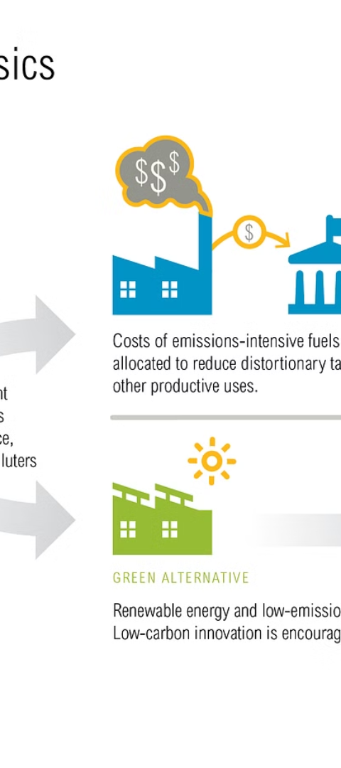
Policy and Support
1
Carbon Pricing
2
R&D Funding
Putting a price on carbon emissions can incentivize the use of low-carbon fuels like algae biofuels.
Continued government and private sector support is crucial for advancing the technology.
3
Regulatory Frameworks
Streamlining regulations and creating incentives can facilitate sustainable biofuel production.

Slide 16



Diverse Algae Strains
Vibrant Colors
Unique Behaviors
Habitat Adaptations
Algae exhibit a wide range of vivid colors, adding exotic beauty to any aquarium.
Each algae species displays intriguing behaviors, from schooling to predatory hunting.
Algae have evolved to thrive in a variety of aquatic environments, making them a diverse group.

Slide 17
Algae Biofuels: A Sustainable Future
Technological Advancements
Breakthroughs in areas like genetic engineering and bioconversion can significantly reduce production costs.
Carbon Pricing
Pricing carbon emissions more heavily can make algae-based biofuels more attractive due to their lower carbon footprint.

Slide 18
Overcoming Challenges
Cultivation Optimization
Efficient Processing
Supportive Policies
Developing advanced extraction and conversion methods can improve the energy efficiency and yield of algae biofuels.
Implementing carbon pricing, funding R&D, and creating favorable regulatory frameworks can drive the adoption of algae biofuels.
Improving algae strains and cultivation systems can enhance productivity and reduce resource requirements.

Slide 19
The Future of Sustainable Fuels
1
Promising Potential
2
Collaborative Efforts
3
Towards a Greener Future
Algae-based biofuels hold great promise as a sustainable alternative to fossil fuels, with the potential to become cost-competitive.
Continued research, development, and policy support are crucial for overcoming the challenges and realizing the full potential of algae biofuels.
Transitioning to algae biofuels can contribute to a more sustainable energy landscape, reducing greenhouse gas emissions and environmental impact.

Slide 20
Conclusion: A Sustainable Future with Algae Biofuel
Advantages
Challenges
Renewable and sustainable
High cultivation costs
Lower carbon footprint
Inefficient processing
Versatile applications
Scaling up production

Slide 21
THANK YOU

